Slide 1
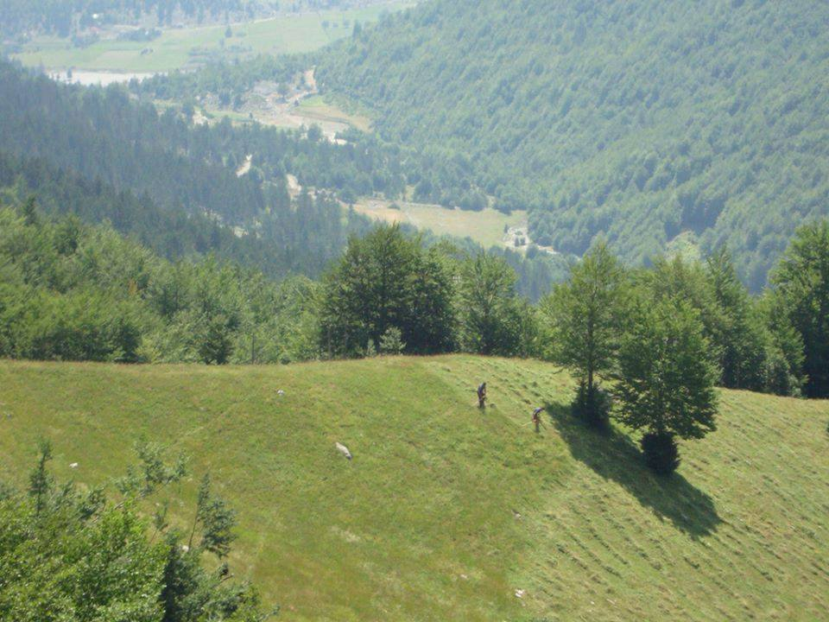
Name :Sami Kryeziu
Country : Republic of Kosovo
Affiliation: NGO: Agro Vet Development
Position: Project manager

Slide 2
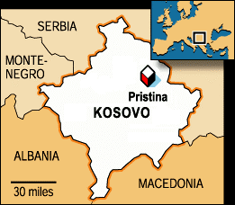
Located in the Balkans, Kosovo has land area of 10,887 square km.
Population is estimated at 2 million.
Located in the centre of the Balkan Peninsula.
It is bordered by Macedonia (FYROM), Albania, Serbia and Montenegro.
The gross domestic product per capita in 2011 was estimated to be 3`71 Euro.
Recognized as state from 107 world countries after proclamation of indipendence (2008).
Kosovo is viewed as a country with potential for a flourishing agricultural industry, but is faced with:
Government budget for Agriculture was 2013 = 13.7 million Euro (2013).
Other international funds 23 million Euros,. Total 42 mil euro.
Low export and high food import.
Low processing and storage capacities
High competition from outside countries
Characterized with small size of landholdings/Farmers.
Low technologies,
Cheap labour cost
Lack of research institutes in different fields of Agriculture etc.

Slide 3
A short history of Agroforestry in our country
Has been recognized in practice and is used as agricultural method of food production from local farmers, but not known as fact and concept.
The remarkably influenced by political circumstances.
2002 start to use as a concept from USAID, and promote.

Slide 4
Agroforestry systems that historically has been used in Kosovo may be classified into:
Agrisilvicultural systems including crops and trees (corn, Robenia, wind breaks).
2. Silvopastoral systems including animals and trees (sheep, cows and fruit orchards “Apple, pear, walnut etc).
3. Agrisilvopastoral systems including crops animal and trees

Slide 5
The current limits to the development of agroforestry in Kosovo
Current situation
Different priorities of government.
Lack of understanding the real concept of Agroforestry from local and central state authorities, farmers and other stakeholders.
Lack of strategy (national and local) level on short and long term context.
Lack of developing proper and sustainable programs for education and training at all levels of Agroforestry.
Lack of budget (or not exists), for Agroforestry within the budget of MAFRED. Local authorities.
Lack of research s in Agroforestry.
Lack of training facilities, University programs.
Need for promotion and capacity building in Agroforestry
The needs are:
Increase the awareness of central and local authorities
Increase the awareness of farmers and others.
Encourage high (agriculture) schools&faculty to include in their school programs.
Different workshops at different levels in Agroforestry.
Improve legislation and harmonize with European Union etc.

Slide 6
Some relevant steps that our organization is following in our country to encourage agroforestry adoption &Promotion.
Meeting local and central authorities (Giving the idea of Agroforestry (Providing them with leaflets, CD and other information).
Established the Agroforestry working group in Kosovo. (lobbying activities). And Euraf members from Kosovo.
indentif y the potential locations, municipalities, farmers that wants to apply Agroforestry.
Encouraging farmers to apply in their orchards (Fruits with chicken production) diversify their production.
Encouraging farmers to revitalize old orchards, forests, old agriculture cooperatives based on Agriculture practices.
Future steps:
Create national magazine on Agroforestry
Organizing a radio programs.
Establishment of demonstration farms.
Field visit of demonstration farms.

Slide 7
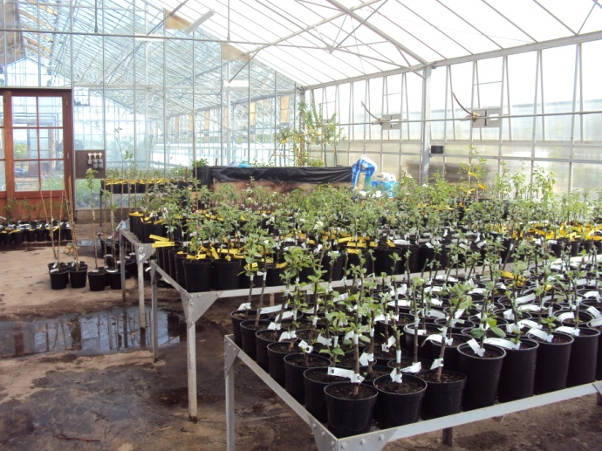
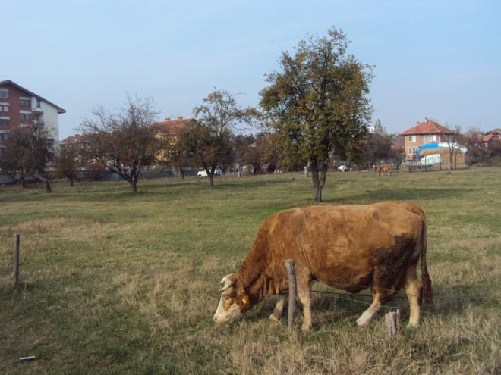
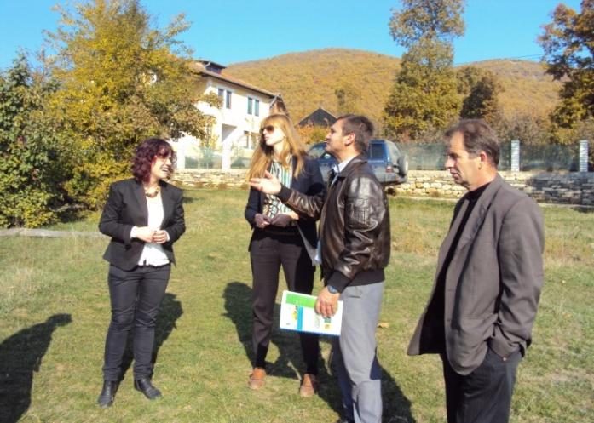
Related with some relevant solutions & Promotion
Establishment of demostration farms.
Developing programs on revitalizations of old orchards.
Field visit of demostration farms.

Slide 8
Thank you for your attention
Danke
www.agrovet-ks.com
Sami.kryeziu@agrovet-ks.com

